Slide 1
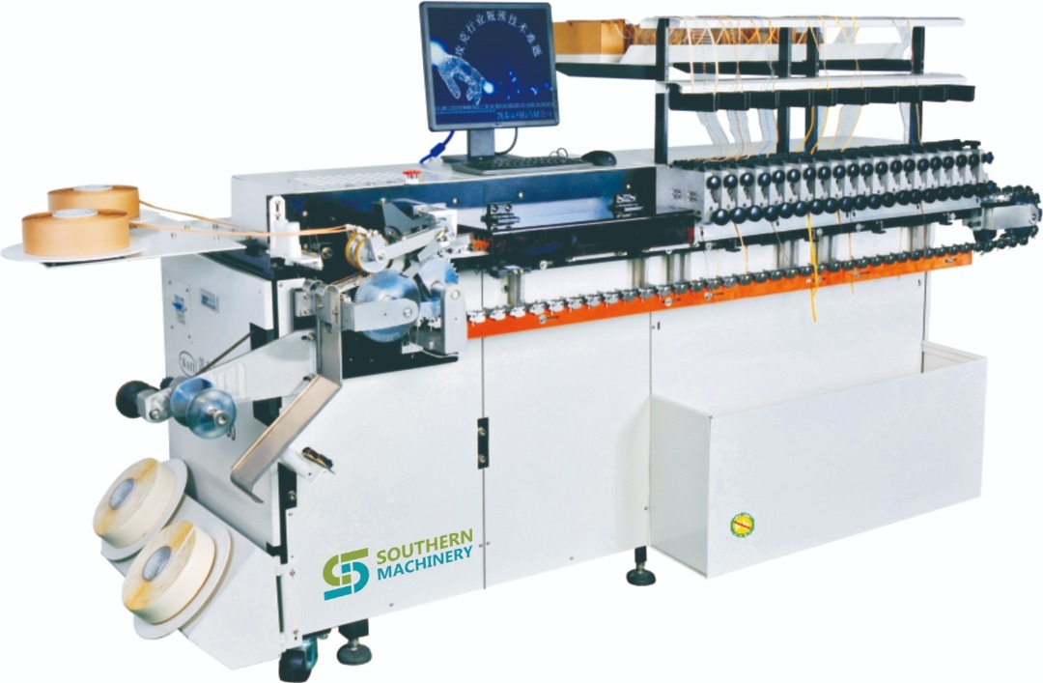
S1000 Axial Sequencer Machine

Slide 2
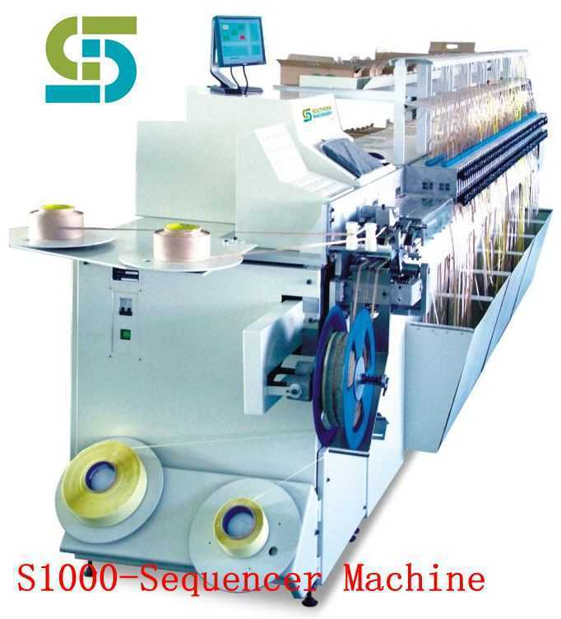
S1000 Axial Sequencer Machine
S-1000 Sequencer machine
Speed：26000CPH
Components requirement:52 MM braid material, component lead spacing of 5.0 MM, element line straightness ± 0.5 MM, element body is < 16 MM, element diameter <5.0
Components species : Capacitors, transistors, diodes, resistors, fuse braid material, etc
Station: 20-100 optional
Power : 220V,AC60HZ,1.0KVZ,08KW
System protect: Soft protection built-in software system
Air pressure: 0.4-0.6 Mpa, 0.3 cubic per minute
Environment temperature: 5-25 degrees
Machine noise: 40 decibels
Test method: double optical fiber
Power system: AC servo
Feeding station power: pneumatic
Data transfer mode: USB interface

Slide 3
Best After-sales service
— 7x24 Worldwide Support
— Free Installation/ Training
— 1 day lead-time (spare parts)
— 1 Month customize solution

Slide 4
Welcome Inquiry
Please visit
www.smthelp.com
Find us more
https://www.facebook.com/autoinsertion
Know more our team
https://cn.linkedin.com/in/smtsupplier
Welcome to our factory in Shenzhen China
See more machine working video, please Youtube
Auto Insertion
Google
Auto+insertion, to get more information
Looking forward to your email
info@smthelp.com

